Slide 1
Super Shopper Store
Kai Rahm

Slide 2
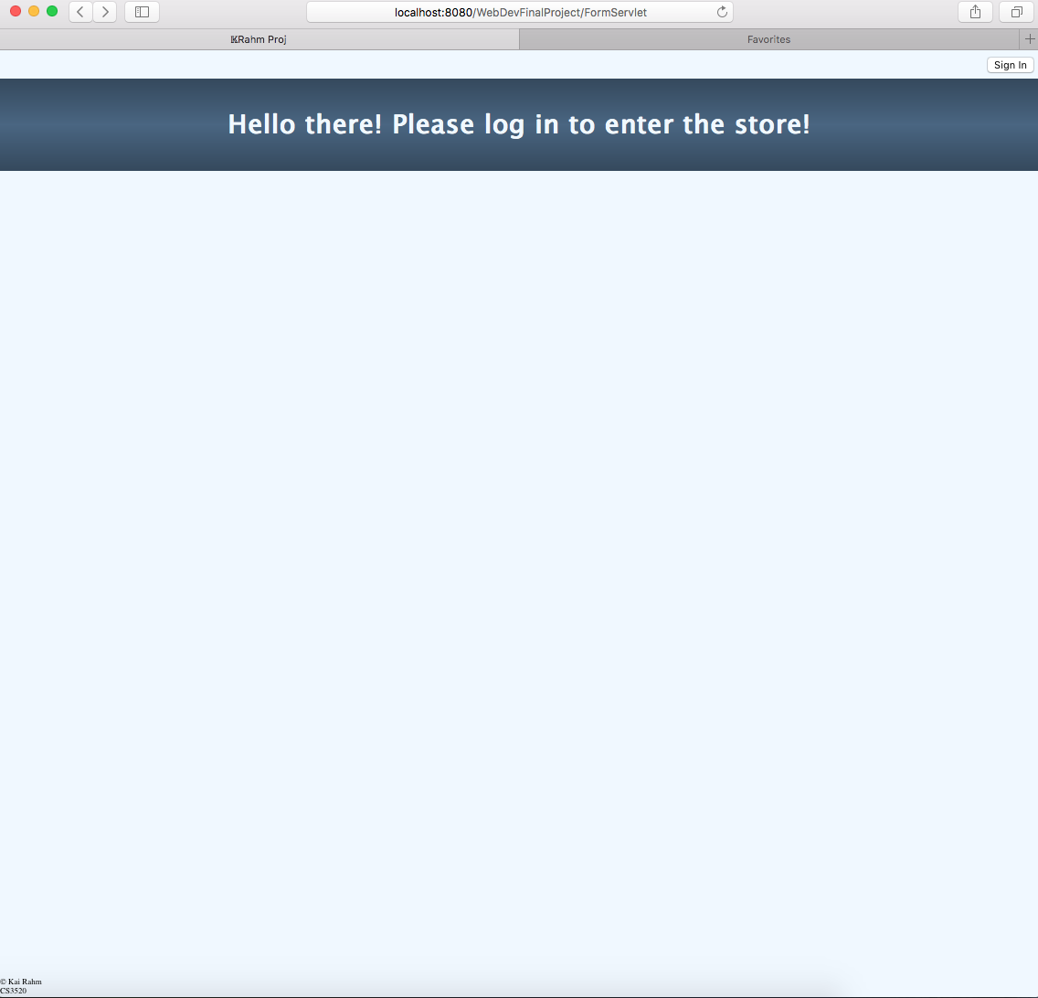
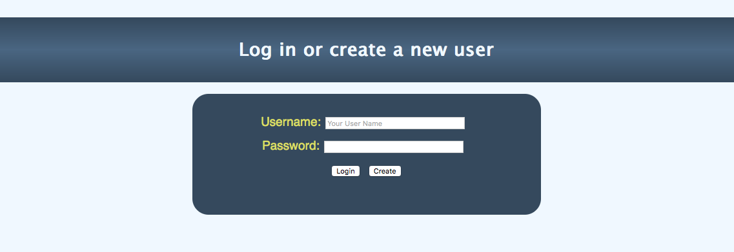
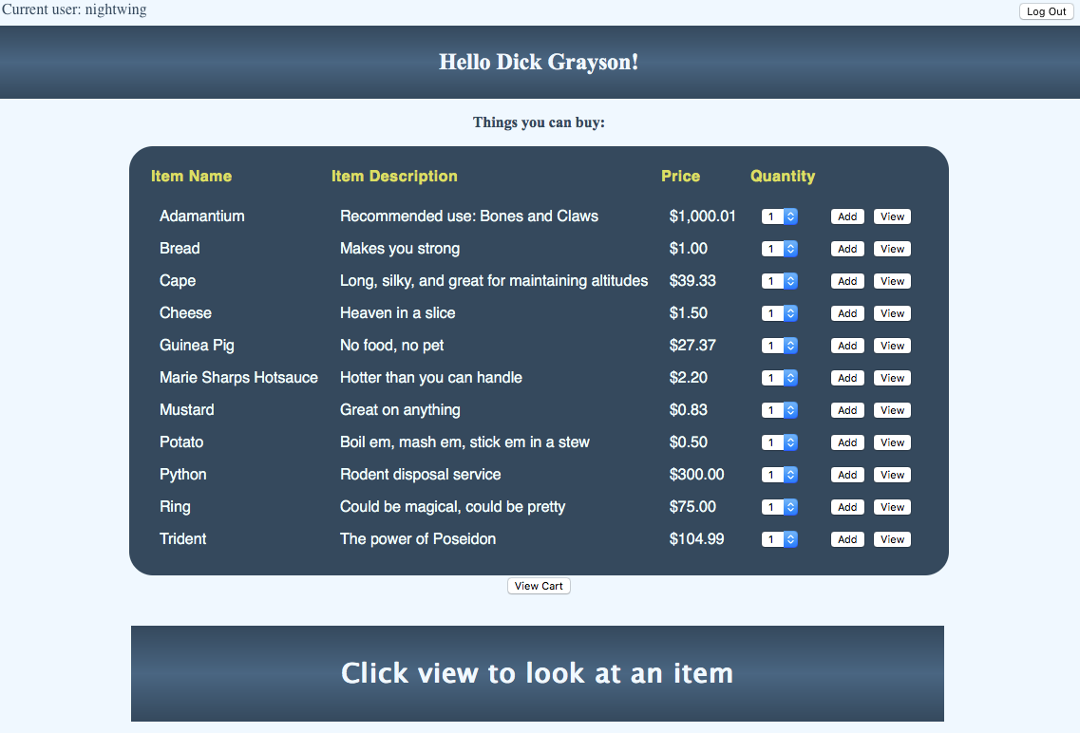
Overview
Simple shopping site
Requires user authentication

Slide 3
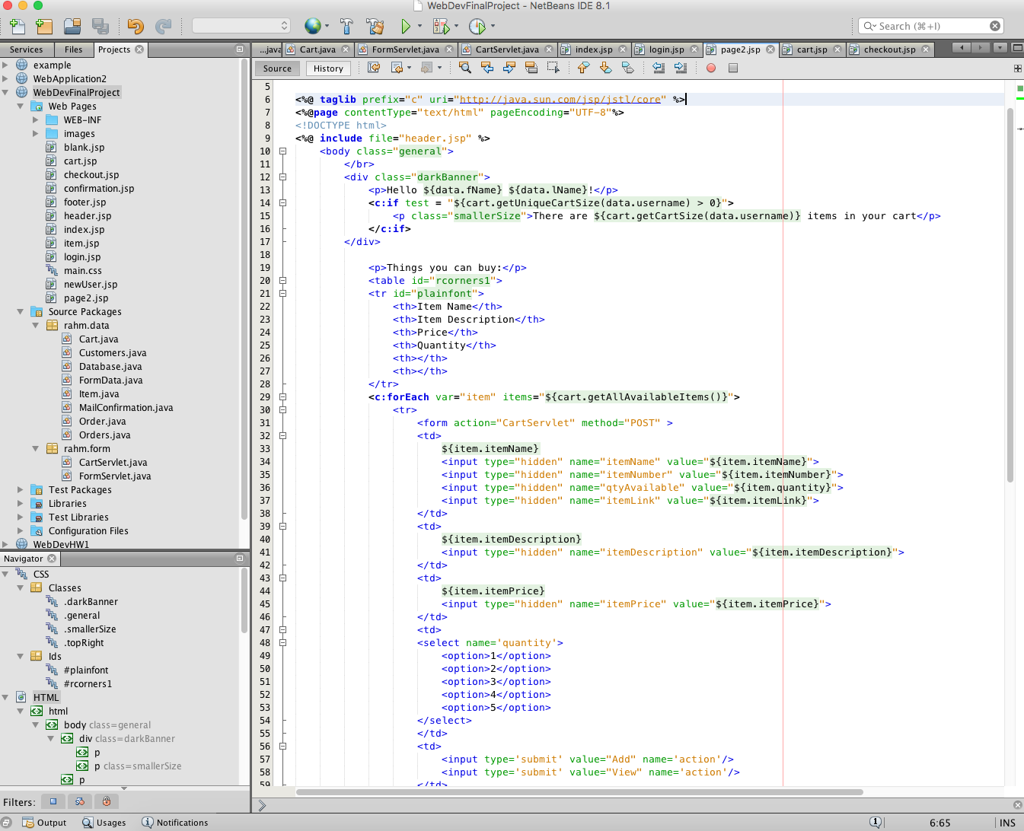
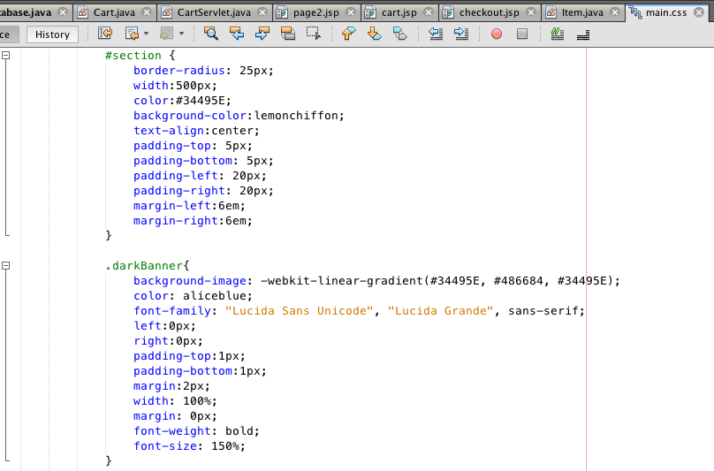
NetBeans
HTML & CSS
JSPs

Slide 4
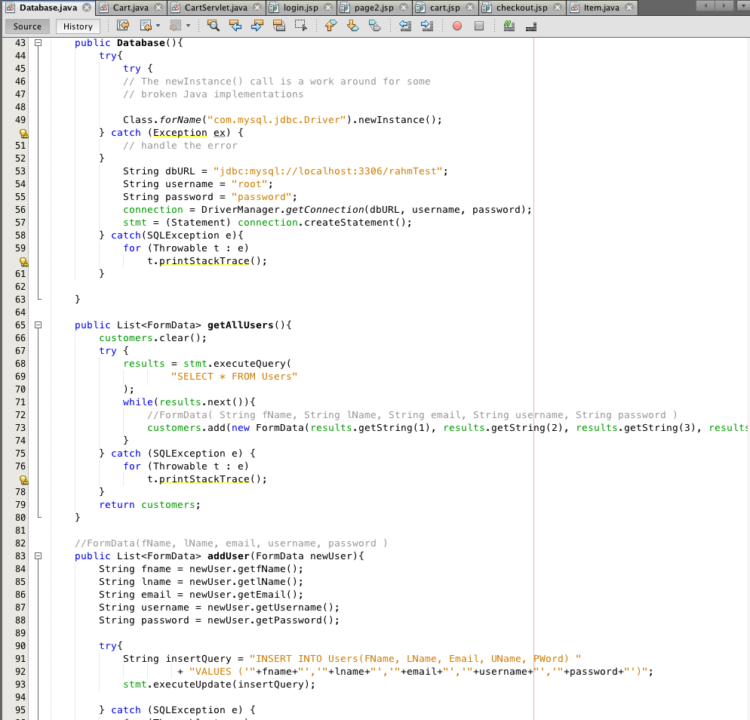
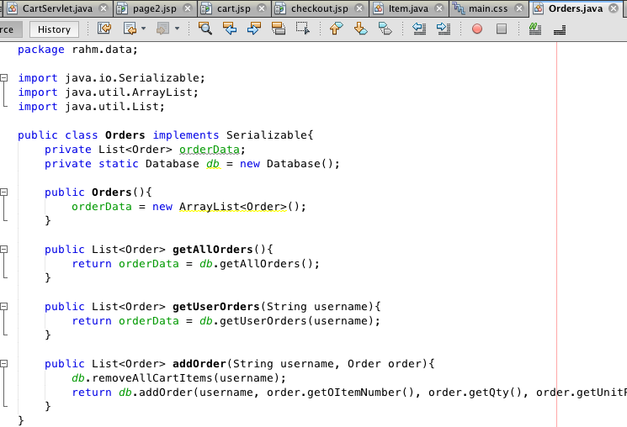
NetBeans
JavaBeans
Customers, Items, Orders
JDBC

Slide 5
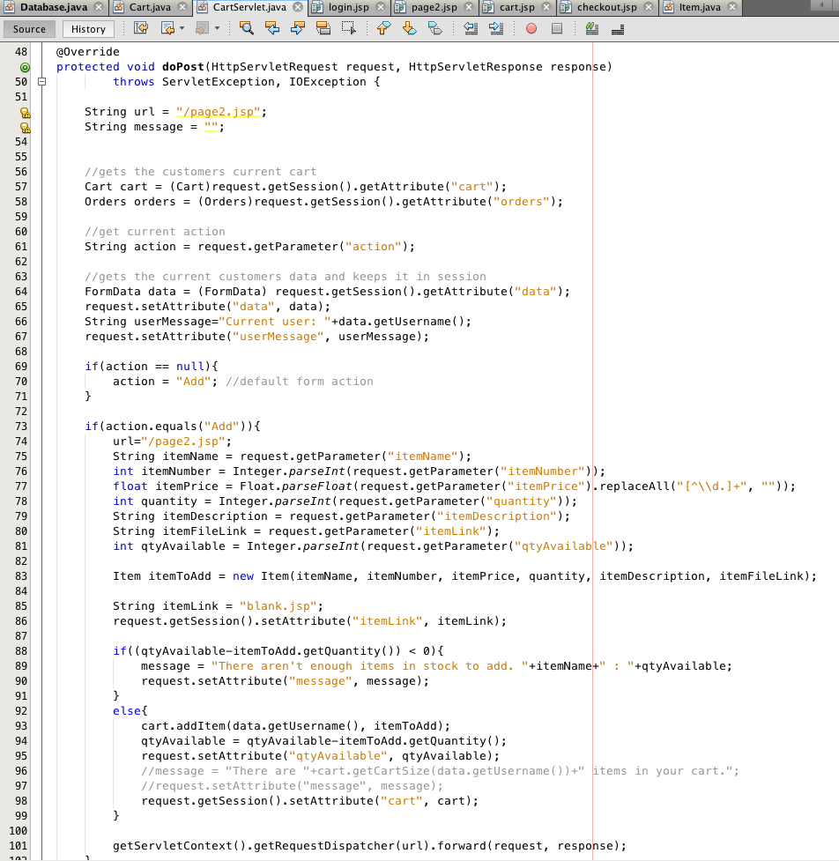
NetBeans
Servlets

Slide 6
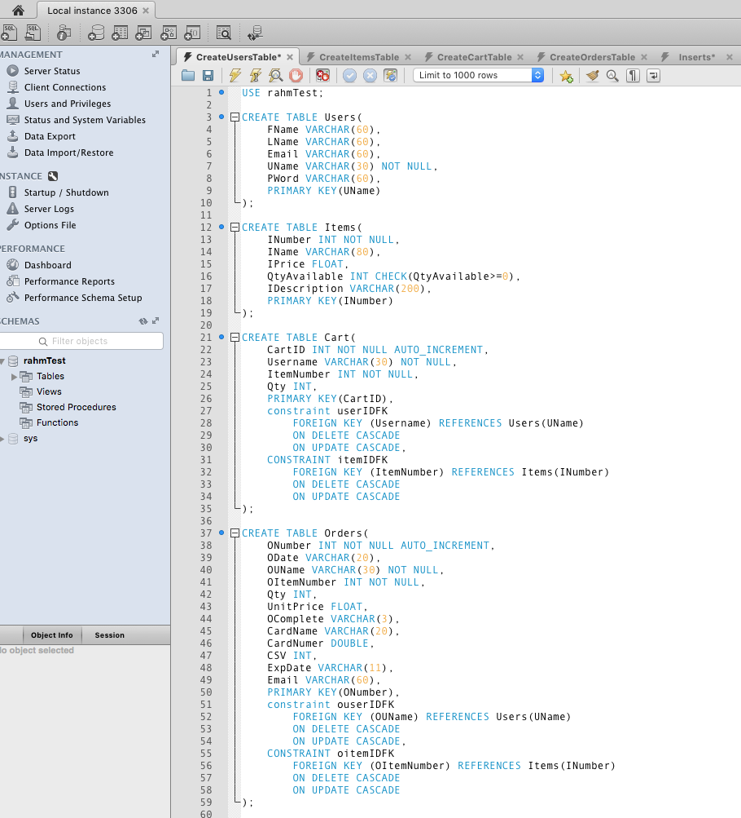
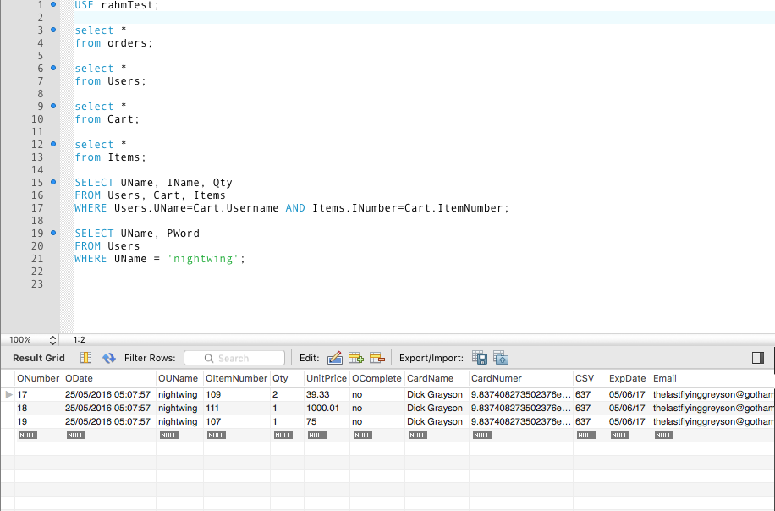
MySQL

Slide 7
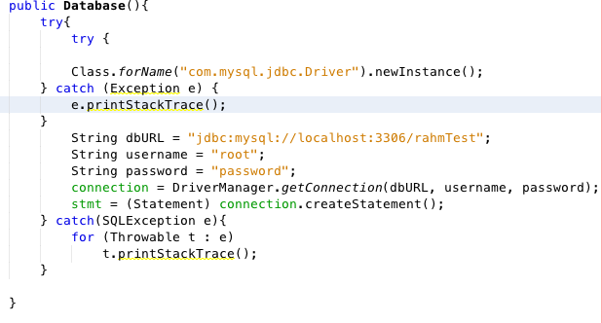
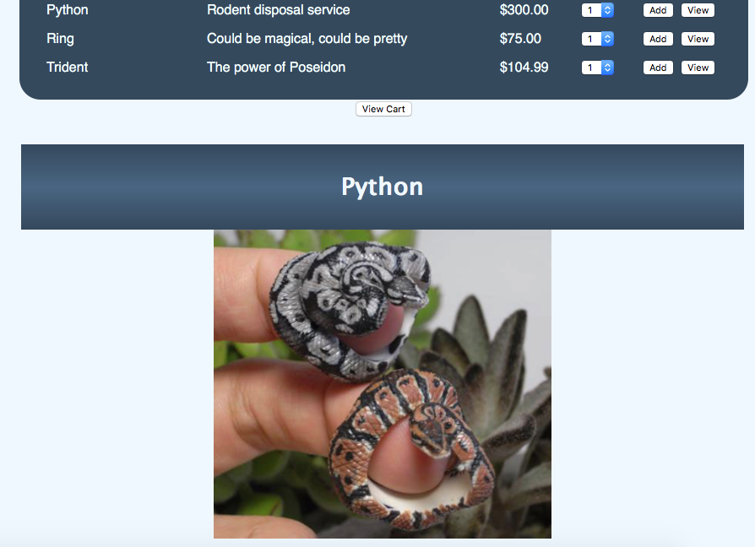
Challenges
Connecting to the DB
Connection import
Debugging SQL Statements
Creating iframe
Set url on ‘view’ click
JSTL tags

Slide 8
Demo Time!
Thank you for listening ☺

